Slide 1




How to SOLVE PROBLEM
In TIME
Without PAIN
Even if RUBBISH

Slide 2
Who is this for?
Notes:
5

Slide 3
What will they no longer need to worry about?
Notes:
5

Slide 4
What will they be able to do after today?
Notes:
5

Slide 5
Why should they care about what you have to say?
Notes:
5

Slide 6
Will they use it?
Notes:
5

Slide 7
Will they stay until the end?
Notes:
5

Slide 8
Why should they listen to me?
Notes:
5

Slide 9
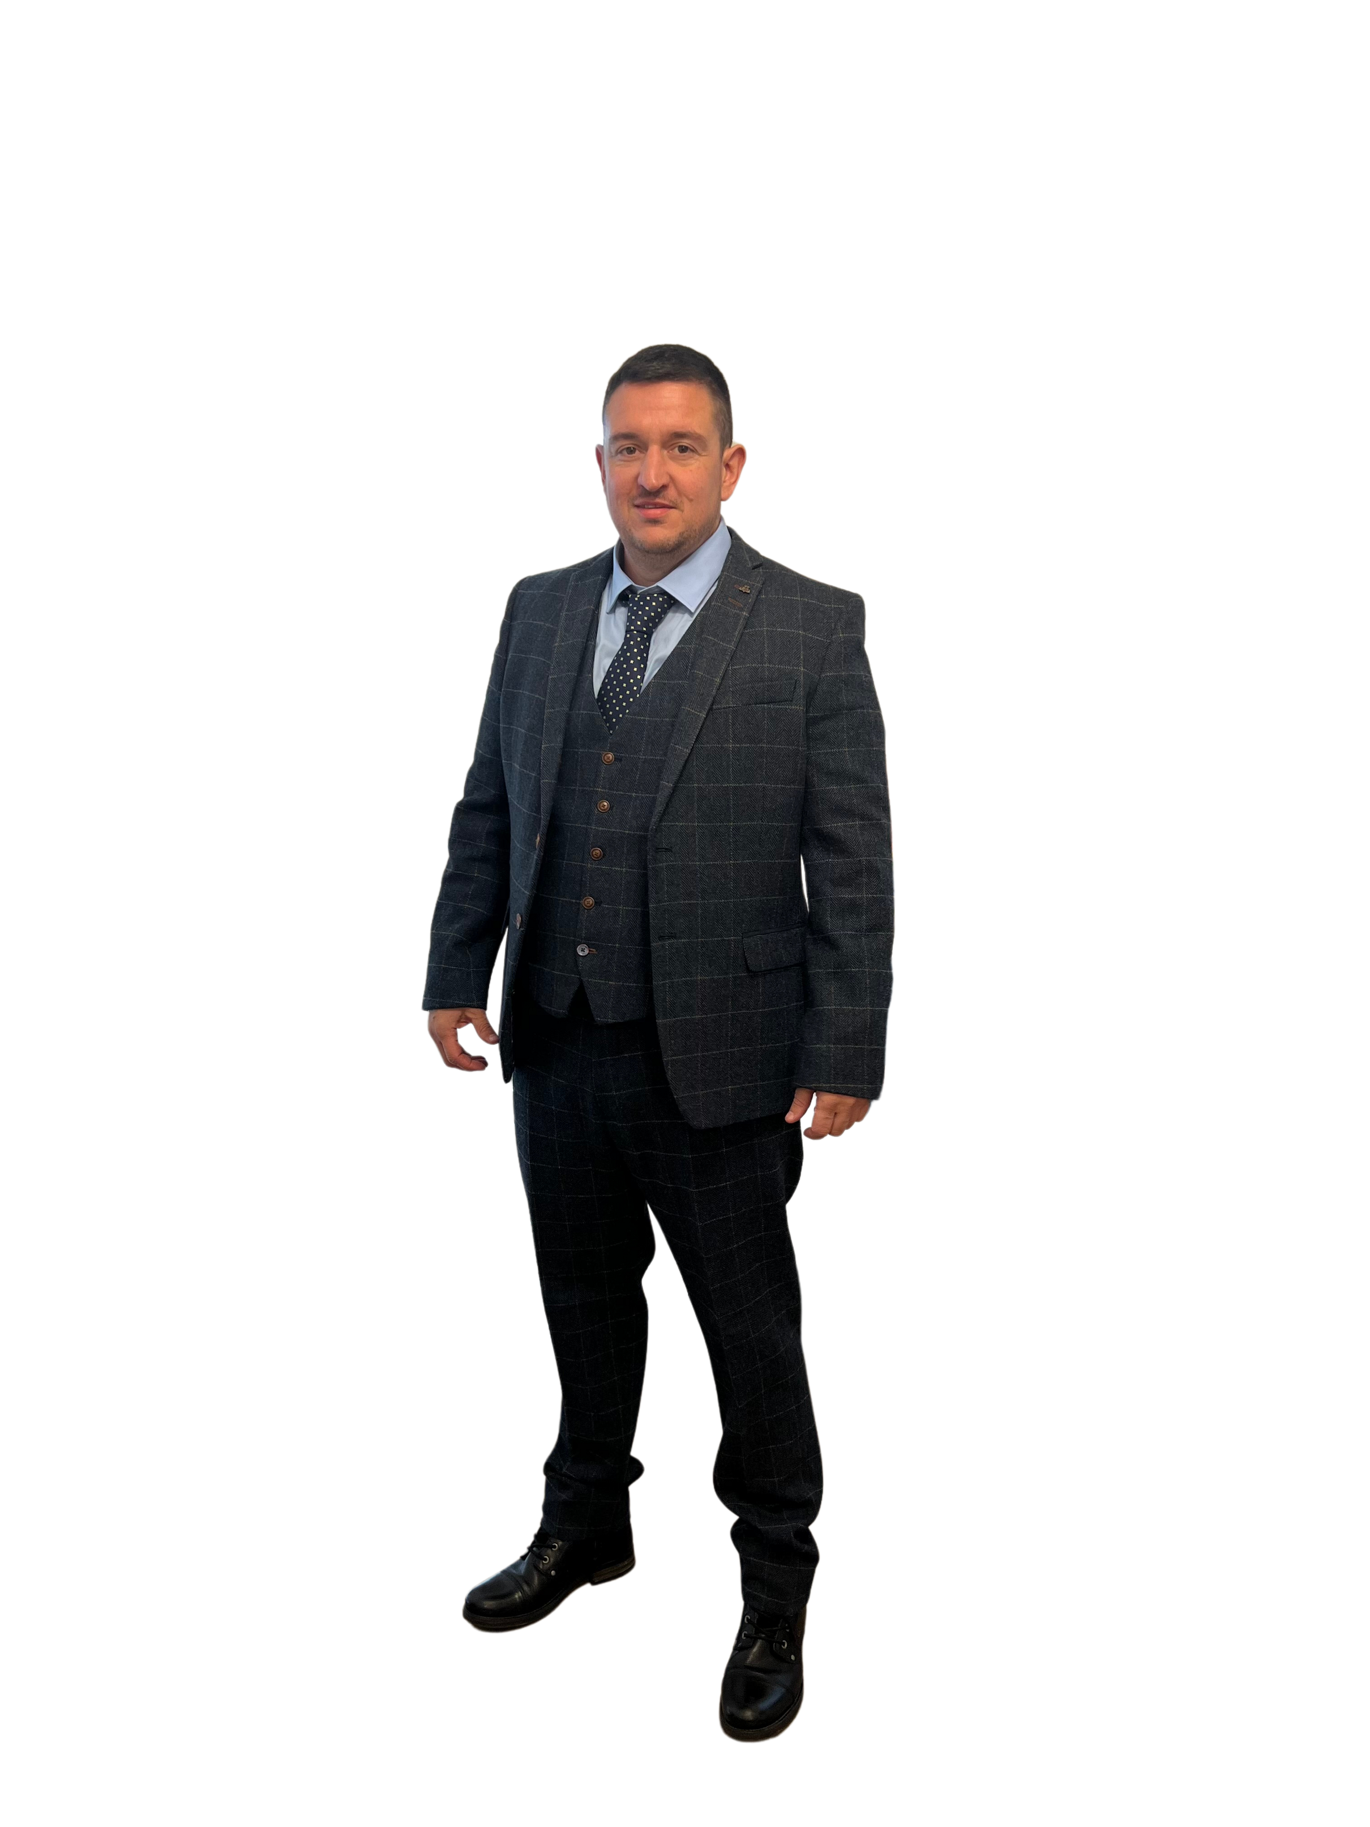
MIKE MARTIN
  SEO Expert
  Entrepreneur
  Business Consultant
  Author
Notes:
3

Slide 10


Books by Mike…

Slide 11

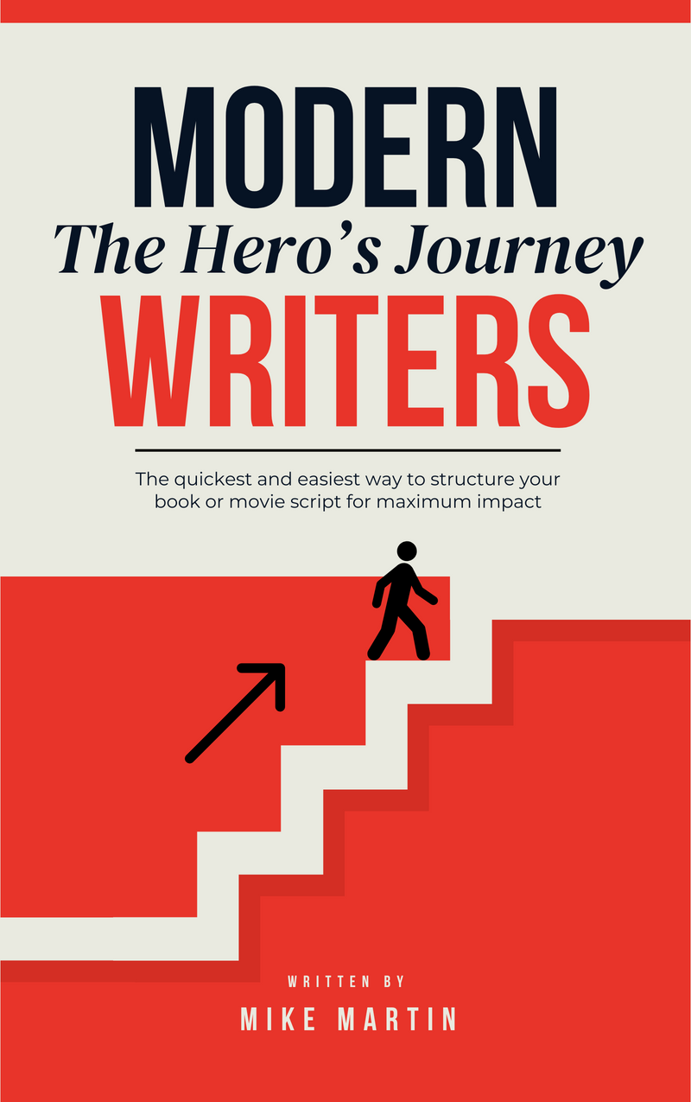
Books by Mike…

Slide 12


Books by Mike…

Slide 13
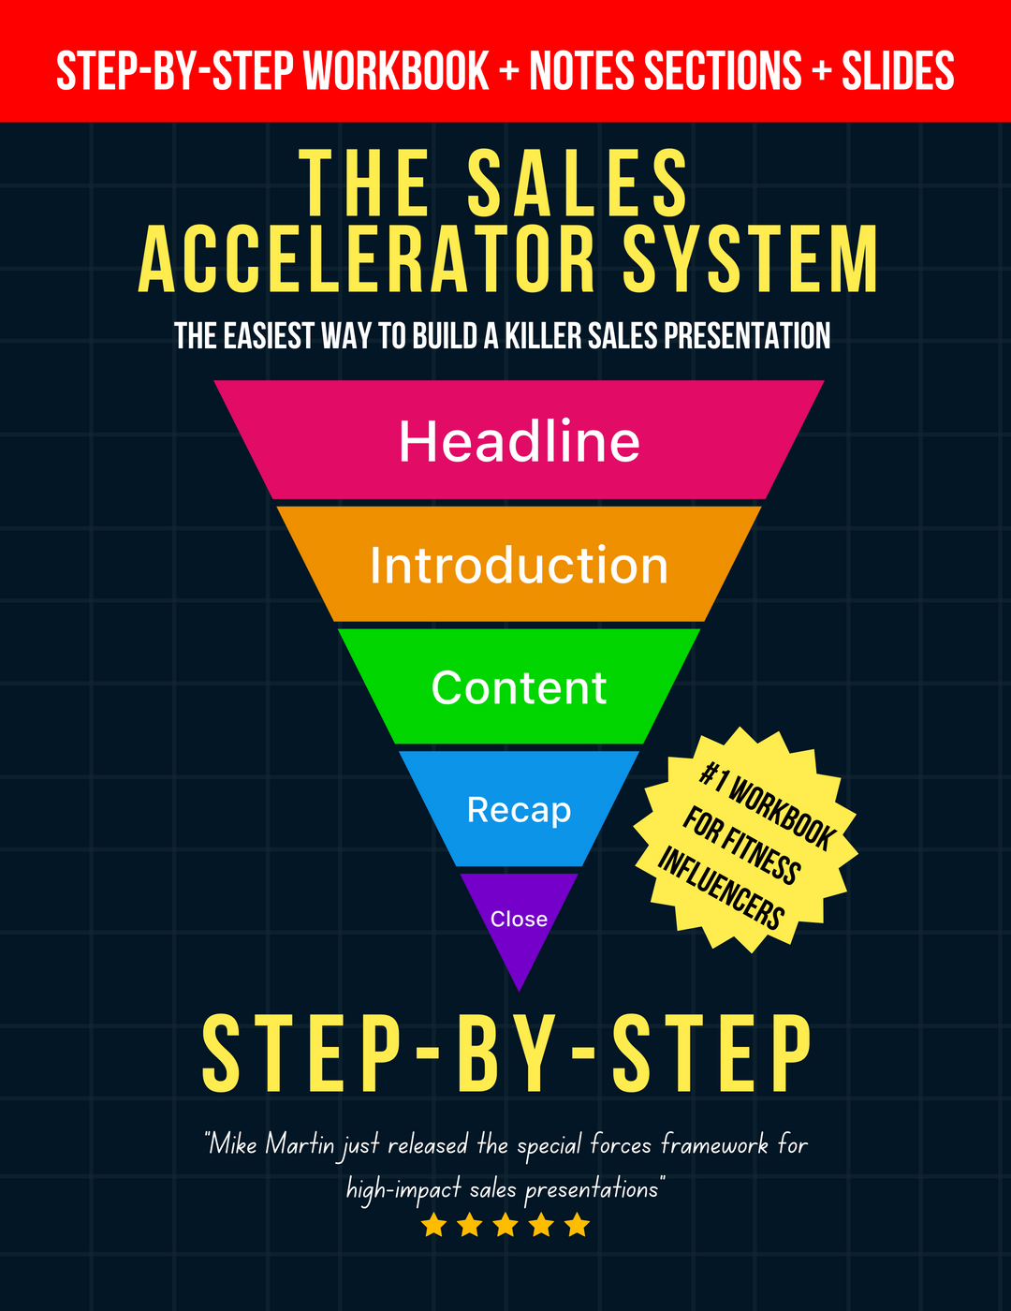
Books by Mike…

Slide 14
Testimonials
Notes:
5

Slide 15
Testimonial Script
  They wanted to achieve this (what your prospect wants)
  They tried by doing this (how your prospect is likely trying)
  They failed because of this (why your prospect is failing and came to the sales presentation)
  They thought all hope was lost
  Then they discovered this (your new way)
  They found success
  Their life now looks like this (how your prospect wants their life to look)
  Social proof
Notes:
46

Slide 16
Backstory
Notes:
5

Slide 17
Backstory Script
  I wanted to achieve this (what your prospect wants)
  I tried by doing this (how your prospect is likely trying)
  I failed because of this (why they are likely failing)
  I thought all hope was lost
  Then I discovered this (you, your company, product or service
  I started doing it a new way (new way)
  I found success
  My life now looks like this (how your prospect wants their life to look)
Notes:
46

Slide 18
What will we cover today?
Notes:
5

Slide 19

SECTION 1,2,3
How to SOLVE BIGGEST PROBLEM / ACHIEVE BIGGEST DESIRE in TIME without PAIN even if RUBBISH.
Notes:
34

Slide 20
Section One - Situation
Notes:
5

Slide 21
Will it work for me?
Notes:
5

Slide 22
Transformation Script
Show people who have already been successful doing this in your ideal prospects niche or obscure niches.
Character
  Scene
  Situation
  Desire
Conflict
  Strategy
  Failure
  Hopeless
Conclusion
  Breakthrough
  Strategy
  Success
  Future
Notes:
46

Slide 23
Multiple Testimonials
Notes:
5

Slide 24
Testimonial Script
  They wanted to achieve this (what your prospect wants)
  They tried by doing this (how your prospect is likely trying)
  They failed because of this (why your prospect is failing and came to the sales presentation)
  They thought all hope was lost
  Then they discovered this (your new way)
  They found success
  Their life now looks like this (how your prospect wants their life to look)
  Social proof
Notes:
46

Slide 25
Section Two - Ability
Notes:
5

Slide 26
Have I got the ability to do it?
Notes:
5

Slide 27
Step by Step Script
  Why is what you're going to show them important?
  What will their future look like with this in place?
  What 3 to 5 step process do they need to do?
  Would you feel stupid doing this any other way?
IMPORTANT
Show them the steps in the process, (an outline) not how to do it, this will be provided after they pay for your product, service, coaching, training.
(The idea here is to show them the roadmap of how they get from where they are to where they want to be)
Notes:
46

Slide 28
Why is what you're going to show them important?
Notes:
5

Slide 29
What will their future look like with this in place?
Notes:
5

Slide 30
What 3 to 5 step process do they need to do?
Notes:
5

Slide 31
Would you feel stupid doing this any other way?
Notes:
5

Slide 32
Multiple Testimonials
Notes:
5

Slide 33
Testimonial Script
  They wanted to achieve this (what your prospect wants)
  They tried by doing this (how your prospect is likely trying)
  They failed because of this (why your prospect is failing and came to the sales presentation)
  They thought all hope was lost
  Then they discovered this (your new way)
  They found success
  Their life now looks like this (how your prospect wants their life to look)
  Social proof
Notes:
46

Slide 34
Section Three - Objections
Notes:
5

Slide 35
Will something or someone stop me?
Notes:
5

Slide 36
3 to 5 common objections
Notes:
5

Slide 37
10 to 20 objection-killers
Notes:
5

Slide 38
Multiple Testimonials
Notes:
5

Slide 39
Testimonial Script
  They wanted to achieve this (what your prospect wants)
  They tried by doing this (how your prospect is likely trying)
  They failed because of this (why your prospect is failing and came to the sales presentation)
  They thought all hope was lost
  Then they discovered this (your new way)
  They found success
  Their life now looks like this (how your prospect wants their life to look)
  Social proof
Notes:
46

Slide 40
60-Second Overview
Notes:
5

Slide 41
Commitment Questions
Notes:
5

Slide 42
Two Choices
Notes:
5

Slide 43
The Close
Notes:
5

Slide 44
Offer
Notes:
5

Slide 45
Bonuses
Notes:
5

Slide 46
Value Price
Notes:
5

Slide 47
If/All
Notes:
5

Slide 48
Deal Price
Notes:
5

Slide 49
Effort
Notes:
5

Slide 50
Cost to Not
Notes:
5

Slide 51
Guarantee
Notes:
5

Slide 52
Urgency
Notes:
5

Slide 53
Scarcity
Notes:
5

Slide 54
Objections
Notes:
5

Slide 55
SLIDE TEMPLATES >>>
Notes:
5

Slide 56
Notes:
69

Slide 57
Headline
Notes:
98

Slide 58
Headline
  Example
  Example
  Example
  Example
  Example
  Example
  Example
Notes:
46

Slide 59
Headline
  Example
  Example
  Example
  Example
  Example
  Example
  Example
  Example
  Example
Notes:
120

Slide 60
Headline
  Headline:
  How to SOLVE BIGGEST PROBLEM / ACHIEVE BIGGEST DESIRE in TIME without PAIN even if RUBBISH.
  Headline:
  How to SOLVE BIGGEST PROBLEM / ACHIEVE BIGGEST DESIRE in TIME without PAIN even if RUBBISH.
  Headline:
  How to SOLVE BIGGEST PROBLEM / ACHIEVE BIGGEST DESIRE in TIME without PAIN even if RUBBISH.
Notes:
32

Slide 61
BIG HEADLINE HERE IN RED
  Example
  Example
  Example
  Example
  Example
  Example
  Example
Notes:
29

Slide 62
Headline
How to SOLVE BIGGEST PROBLEM / ACHIEVE BIGGEST DESIRE in TIME without PAIN even if RUBBISH.
Notes:
34

Slide 63
Headline
  Example.
  Example.

Slide 64
Headline
  Example
  Example
  Example
Notes:
9

Slide 65
Headline
Insert Sub-Headline Here…
Notes:
11

Slide 66
Headline
Notes:
38

Slide 67
Headline
Notes:
42

Slide 68
Headline
Notes:
44

Slide 69
Headline
Notes:
48

Slide 70
Headline
Notes:
50

Slide 71
Headline
Notes:
51

Slide 72
Headline
Sub Headline
Notes:
53

Slide 73
Headline
Sub-Headline
Notes:
54

Slide 74
Headline
Notes:
55

Slide 75
Headline!
Sub Headline
How to SOLVE BIGGEST PROBLEM / ACHIEVE BIGGEST DESIRE in TIME without PAIN even if RUBBISH
Notes:
57

Slide 76
Headline!
How to SOLVE BIGGEST PROBLEM / ACHIEVE BIGGEST DESIRE in TIME without PAIN even if RUBBISH.
Notes:
59

Slide 77
Headline
  Example
  Example
  Example
  Example
Notes:
67

Slide 78
Headline
Sub Headline
Notes:
68

Slide 79
Notes:
73

Slide 80
BIG HEADLINE HERE
ON MORE
LINES HERE
Sub Headline
How to SOLVE BIGGEST PROBLEM / ACHIEVE BIGGEST DESIRE in TIME without PAIN even if RUBBISH.
Notes:
75

Slide 81
Headline
How to SOLVE BIGGEST PROBLEM / ACHIEVE BIGGEST DESIRE in TIME without PAIN even if RUBBISH.
Notes:
77

Slide 82

Notes:
85

Slide 83
Headline
Notes:
89

Slide 84
“They Helped me SOLVE BIGGEST PROBLEM / ACHIEVE BIGGEST DESIRE in TIME without PAIN even though RUBBISH.”
Name
Notes:
104

Slide 85
Sub Headline
Headline
  Example
  Example
Notes:
111

Slide 86
Headline
Notes:
124

Slide 87
Headline
  Example
  Example
  Example
  Example
  Example
($ Value)
($ Value)
($ Value)
($ Value)
($ Value)
$ Total Value
Notes:
129

Slide 88
Headline
  Example
  Example
  Example
  Example
  Example
  Example
Notes:
137

Slide 89
Headline
Notes:
139

Slide 90
Headline
Notes:
144

Slide 91
Headline
PRICE
Get Started Now: www.mikemartin.uk
Notes:
176

Slide 92
Headline
Sub Headline
Get Started Now: www.mikemartin.uk
Notes:
178

Slide 93
Get Started Now: www.mikemartin.uk
Notes:
179

Slide 94
Headline
  Headline – How to SOLVE BIGGEST PROBLEM / ACHIEVE BIGGEST DESIRE in TIME without PAIN even if RUBBISH.
  Headline – How to SOLVE BIGGEST PROBLEM / ACHIEVE BIGGEST DESIRE in TIME without PAIN even if RUBBISH.
Get Started Now: www.mikemartin.uk
Notes:
181

Slide 95
Guarantee
How to SOLVE BIGGEST PROBLEM / ACHIEVE BIGGEST DESIRE in TIME without PAIN even if RUBBISH.
Get Started Now: www.mikemartin.uk
Notes:
183

Slide 96
Headline
How to SOLVE BIGGEST PROBLEM / ACHIEVE BIGGEST DESIRE in TIME without PAIN even if RUBBISH.
Get Started Now: www.mikemartin.uk
Notes:
185

Slide 97
What You’re Gonna Get…
  Insert Your Offer Here ($ Value)
  Insert Your Offer Here ($ Value)
  Insert Your Offer Here ($ Value)
  Insert Your Offer Here ($ Value)
  Insert Your Offer Here ($ Value)
Total Value: $
Notes:
187

Slide 98
URGENCY / SCARCITY
Get Started Now: www.mikemartin.uk

Slide 99
What Our (Your Offer) Members Get…
  Insert Your Offer Here…
  Insert Your Offer Here…
  Insert Your Offer Here…
  And MORE!!!
Get Started Now: www.mikemartin.uk
Notes:
190

Slide 100
Headline
Get Started Now: www.mikemartin.uk
Notes:
193

Slide 101
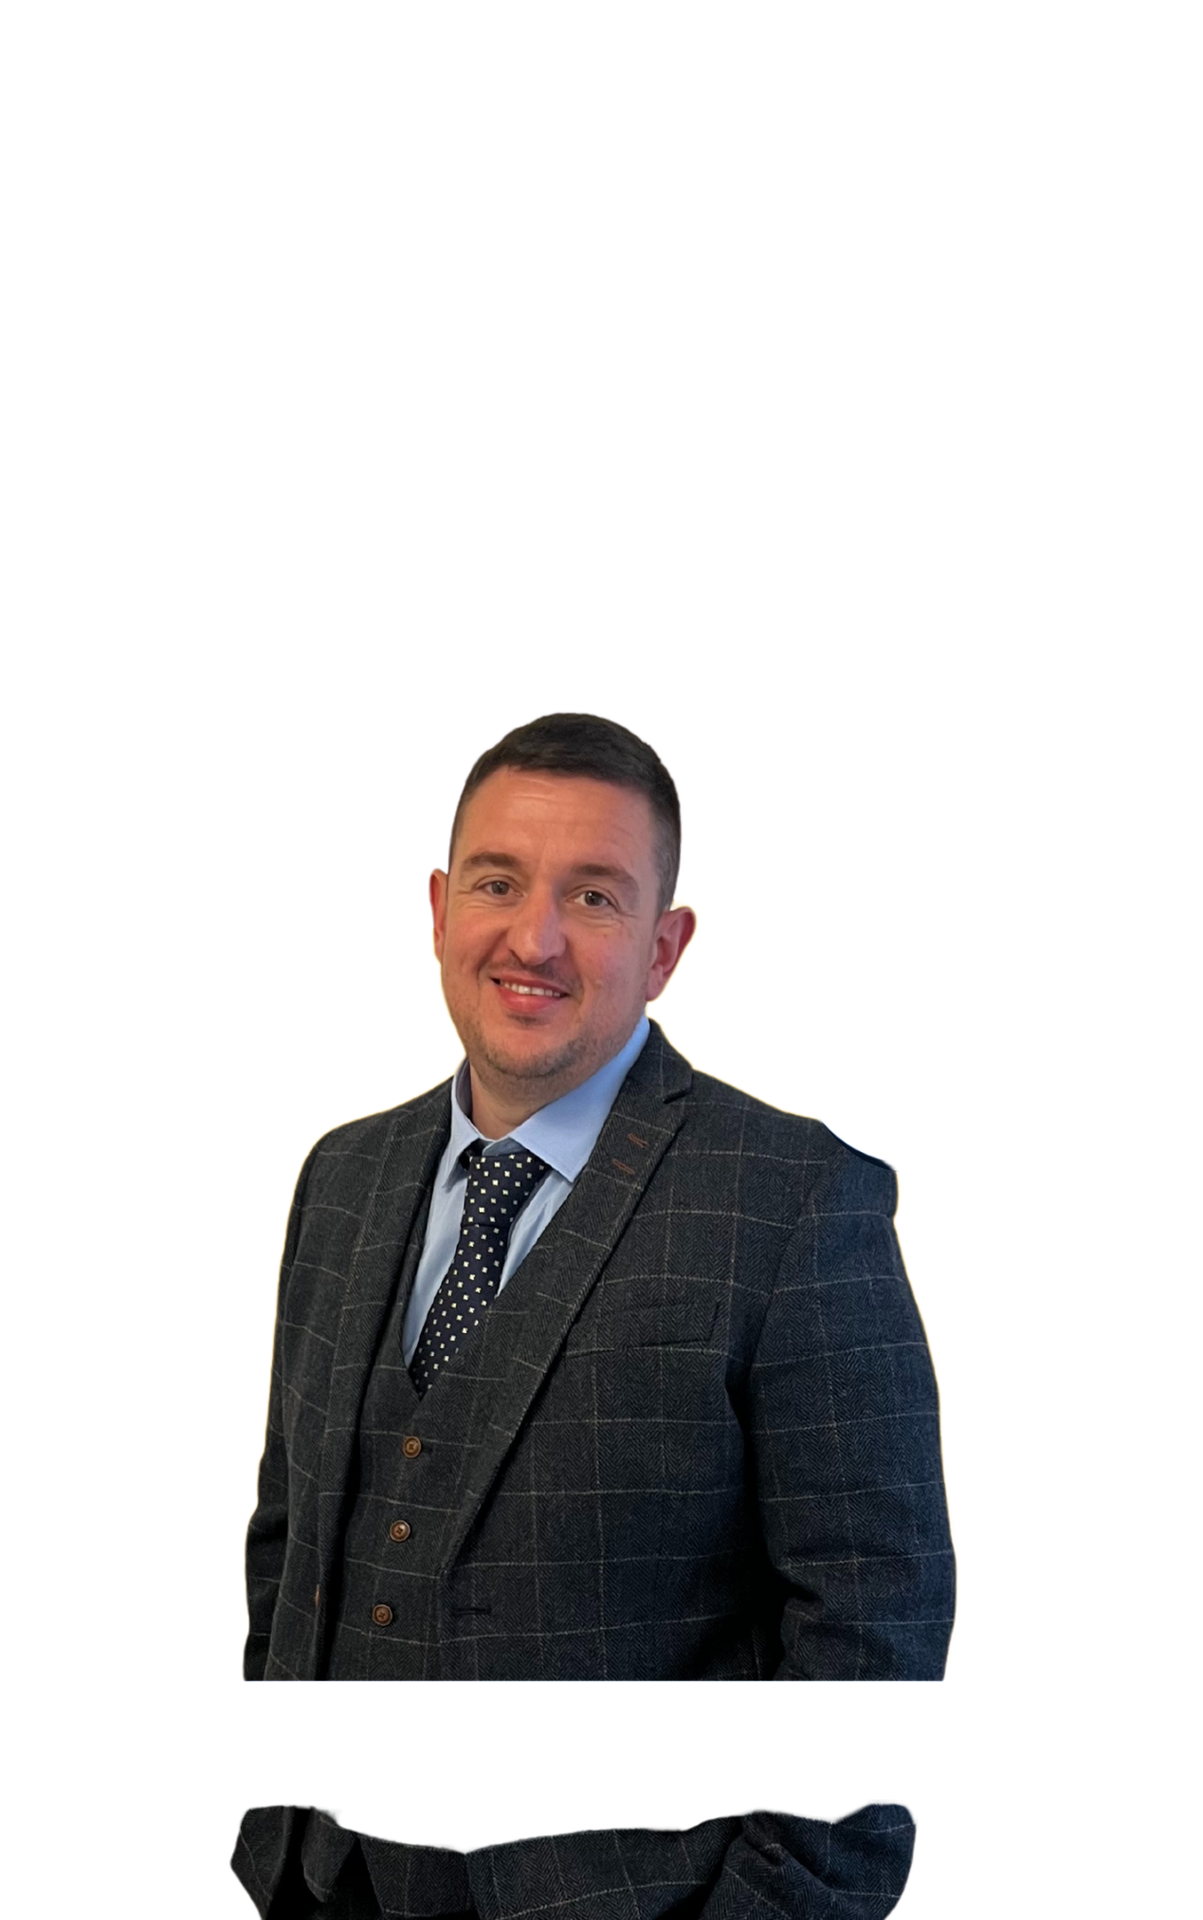
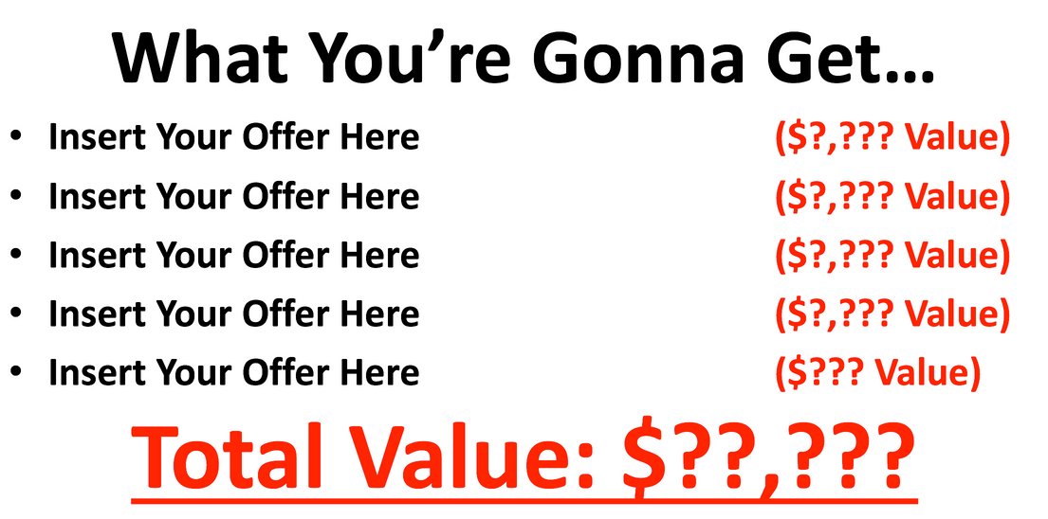
Get Started NOW For Just
$ Today
Questions:
Get Started Now: www.mikemartin.uk
Still Have Questions…?
Email us at support@yoursite.com
Notes:
194

